Slide 1

Evaluating Zeek IDS Throughput when Deployed on Containers
Mentor: Sourav Panda
Tingyi Xie
Qun Lou
Jan 27, 2021

Slide 2

Problem Statement
&
Motivation

Slide 3

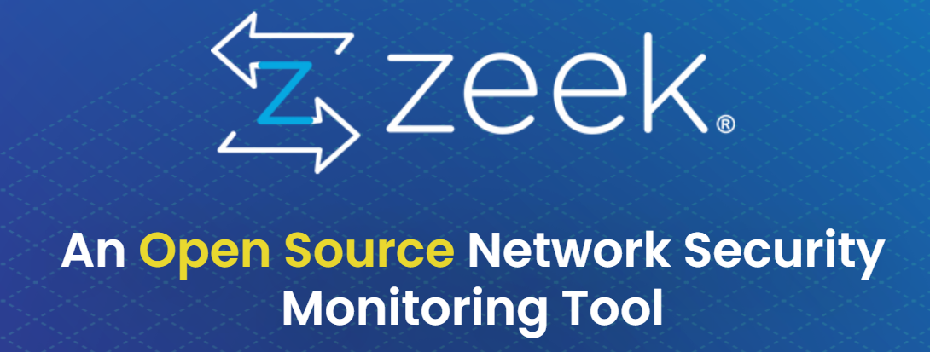
Evaluating Zeek Throughput when Deployed on Containers
Problem Statement
What is Zeek?
Zeek (formerly Bro IDS) is an Intrusion Detection System(IDS) that monitors attacks and threats towards secure networks.
What are we going to do?
In general, we want to exert both penetration test and pressure test on Zeek IDS which are deployed on docker containers.
More specifically, we will study the important factors ,including hardware resource usage, packet processing rate/drop rate, and detection accuracy, which limit the applicability of Zeek IDS to high-throughput networks.

Slide 4
Evaluating Zeek Throughput when Deployed on Containers
Motivation
Why our project matters?
Hundreds of thousands of companies and persons are using Zeek to protect their networks now.
A considerable part of them deploy Zeek on dockers and are face with numerous network activities every day.
Few related papers throw light on Zeek.
What can the project be used for?
Get Zeek’s performance (detection accuracy, packet arrival rate) under different network pressure
Find bottlenecks and give possible solutions
Compared to the studies on different IDSs

Slide 5
Related Works

Slide 6
Evaluating Zeek Throughput when Deployed on Containers
Related Works
《Analysing performance issues of open-source intrusion detection systems in high-speed networks》
《Performance evaluation comparison of snort NIDS under linux and windows server》
《Evaluating network intrusion detection systems for high-speed networks》
《Intrusion detection at 100g》
《Comprehensive Performance Assessment on Open Source Intrusion Detection System》
《A comparative analysis of the Snort and Suricata intrusion-detection systems》
…..
In conclusion, the related papers provide us with many inspiring methods and useful results for future comparisons.
Most of them just work on Snort and Suricata (the two closest rivals to Zeek).

Slide 7
Methodology
&
Tools

Slide 8
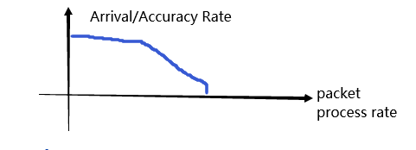
Evaluating Zeek Throughput when Deployed on Containers
Methodology
First, we will evaluate the performance of single-instance Zeek
With a stable [packet processing rate] and an increasing [hardware resource]
1. Best【Packet Arrival Rate】
2. Best【Intrusion Detection Accuracy】
3.【Minimum CPU cores/memory/…/】to reach the best performance.
With an increasing [packet processing rate] to get the relationship between [packet processing rate] and 【accuracy/arrival rate】
Then, we will work on the Zeek Clusters
Use the same methods for clusters.
And as we predict, a possible result could be :
“ “Snort and Suricata are not able to handle network throughput higher than 5 Gb/s”
——《Analysing performance issues of open-source intrusion detection systems in high-speed networks》
Finally, we will compare and conclude those results.

Slide 9
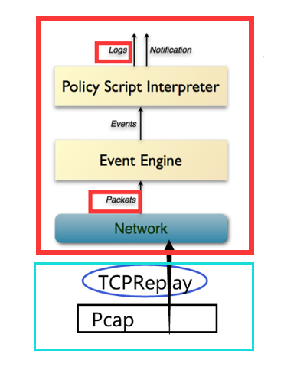
Evaluating Zeek Throughput when Deployed on Containers
single instance Zeek
Architecture Tools
Zeek: Monitor
TCPReplay: Sender
ParseZeekLogs @https://github.com/dgunter/ParseZeekLogs
Zeek
TCP Replay: a tool to modify the Pcap and resend it
PcapXray: draw cool topology graph and get hyper info for Pcap
Pcap: from “NB15” – a widely used modern cyber security dataset
with classified cyber attacks flows (Brute-Force, Backdoors, … )

Slide 10
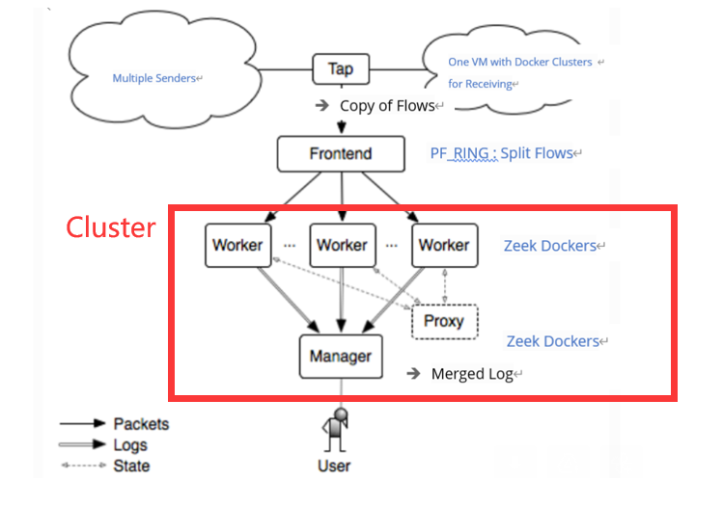
Evaluating Zeek Throughput when Deployed on Containers
Zeek Dockers Cluster
Architecture
Zeek is single-threaded
One (maybe) useful dockerfile: https://hub.docker.com/r/fixel/zeek-cluster
Fig modified from Zeek’s Official Doc

Slide 11
Goals

Slide 12
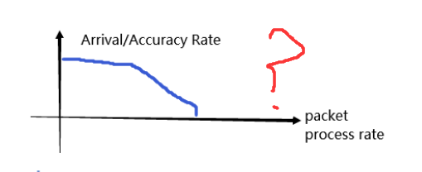
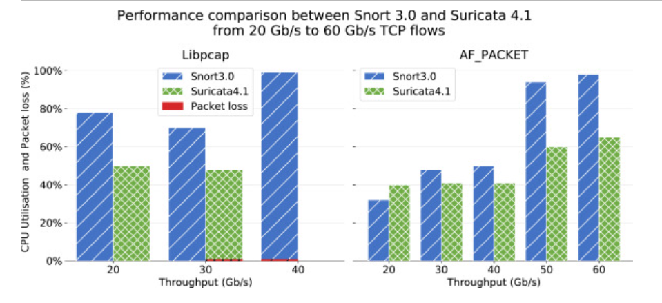
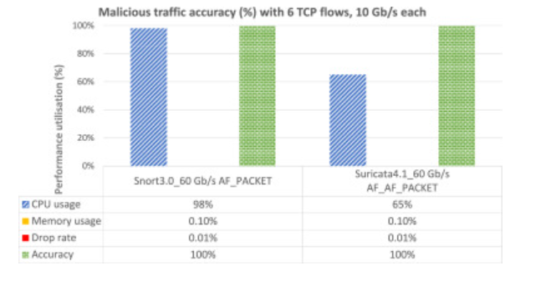
Evaluating Zeek Throughput when Deployed on Containers
Goals
At least,
Experiment on different vital factors (hardware resource usage, packet processing rate and drop rate, and detection accuracy) that limit the applicability of Zeek IDS to high-throughput networks.
Find the relationship between detection accuracy and packet processing rate.
Higher goals :
Point out the bottlenecks and possible relief solutions
Compare our results to the similar studies on other IDSs
Fig from https://www.sciencedirect.com/science/article/pii/S2214212619306003

Slide 13
Evaluating Zeek Throughput when Deployed on Containers
Thanks!
Mentor: Sourav Panda
Tingyi Xie
Qun Lou
Jan 27, 2021

